Slide 1
Bonsuck Koo
GNC Engineer (Early Career) Panel Interview

Slide 2

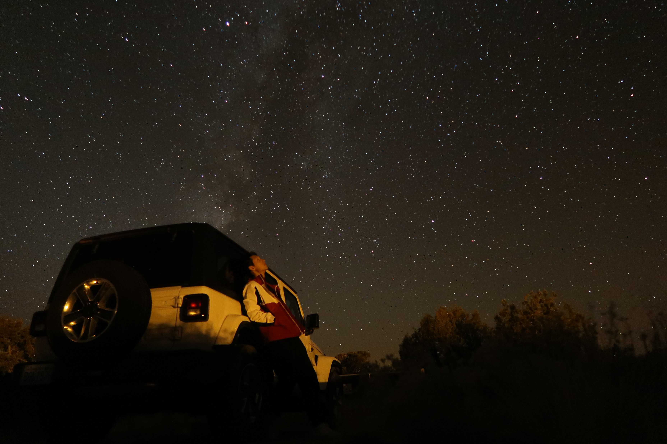
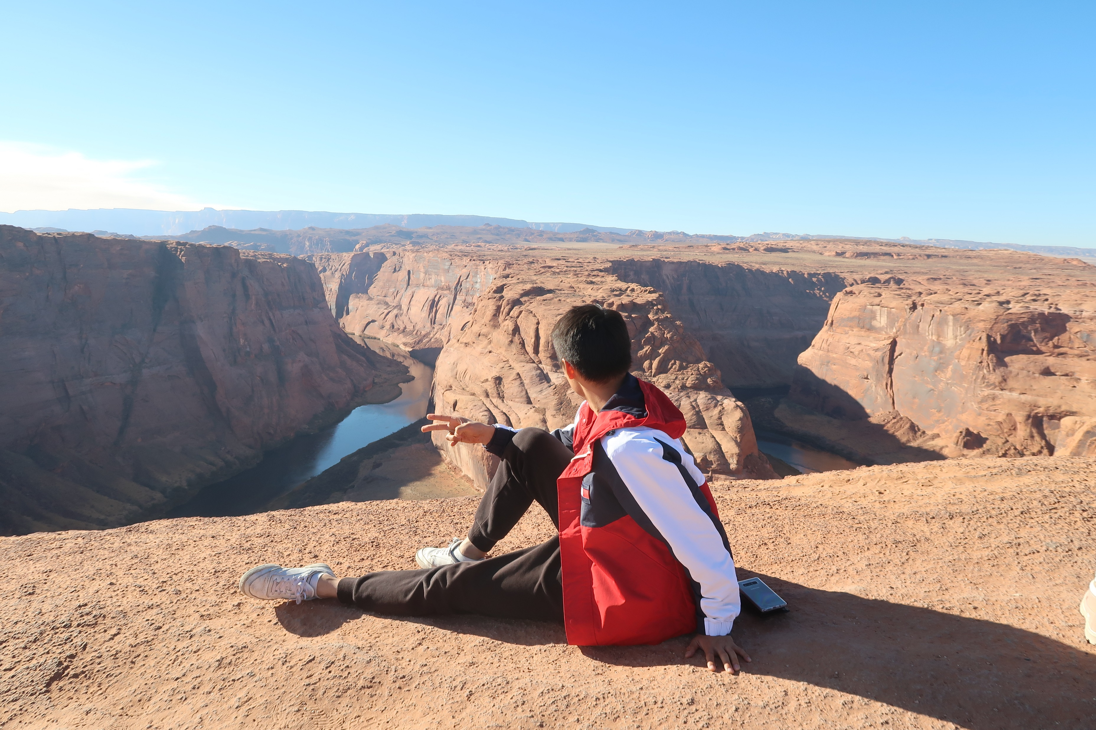
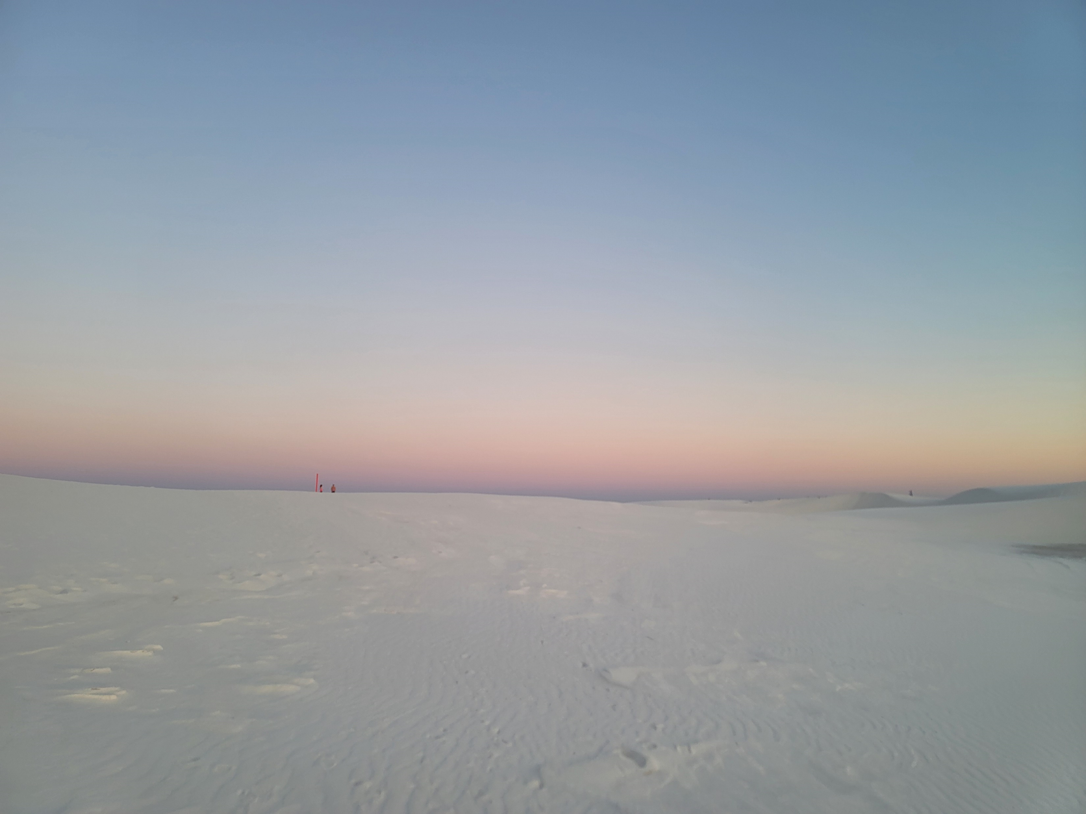
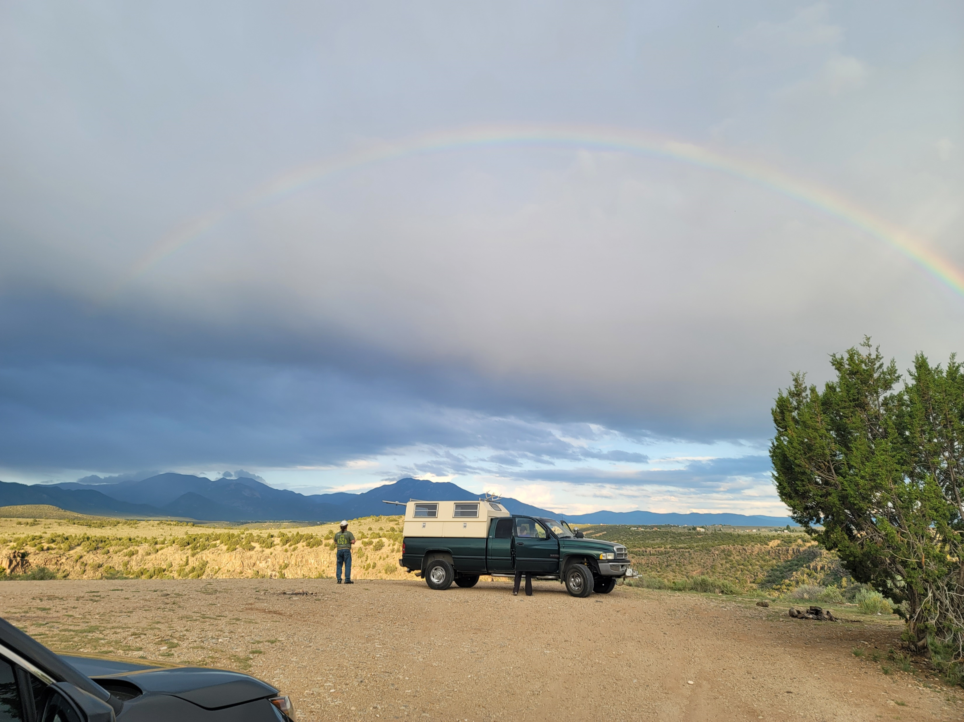
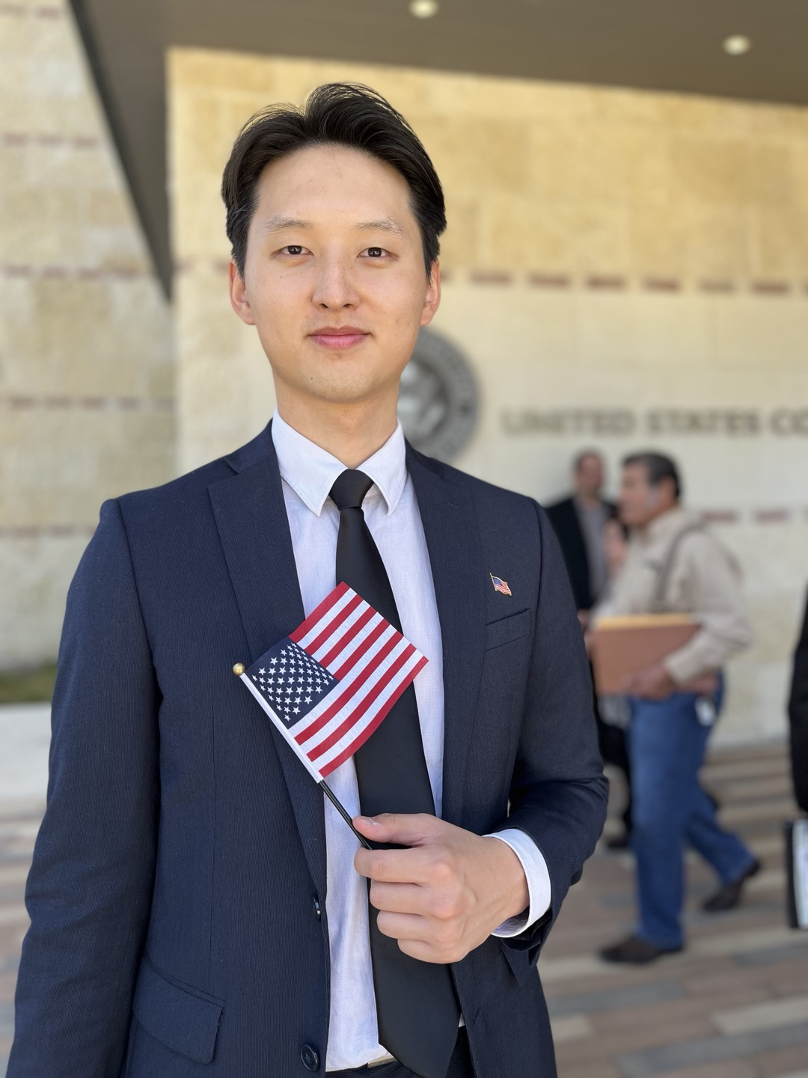
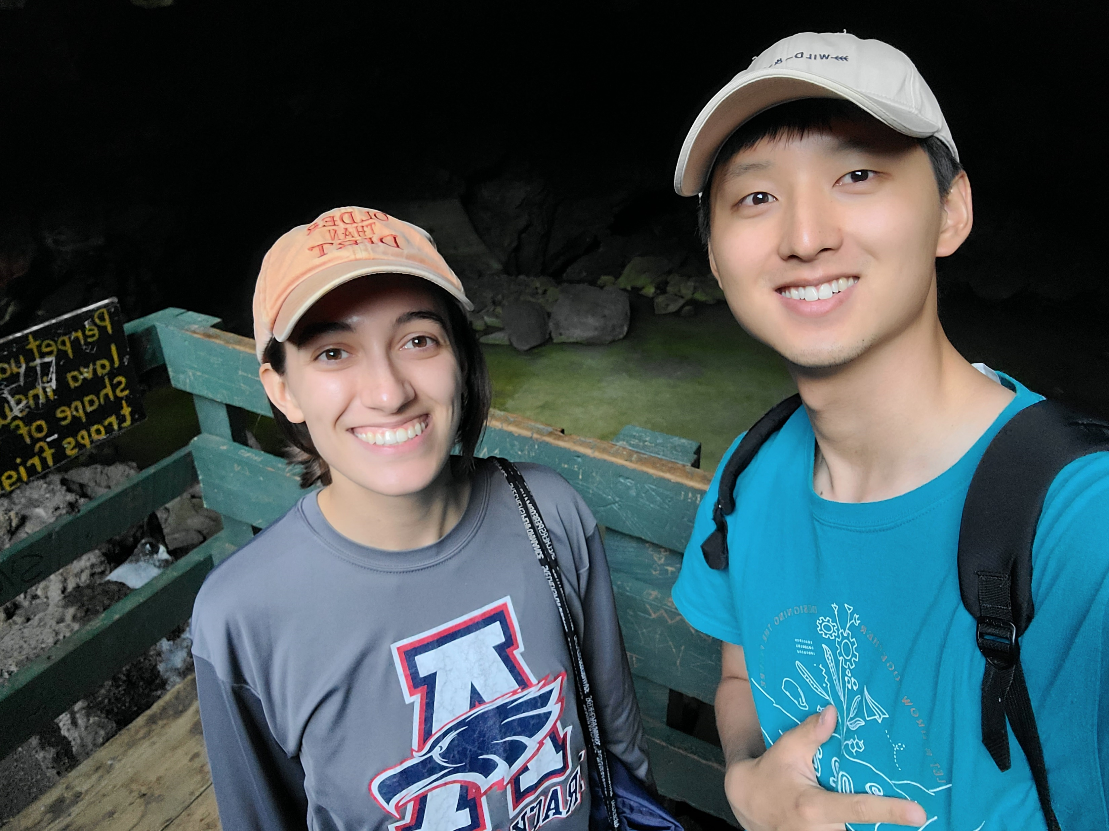
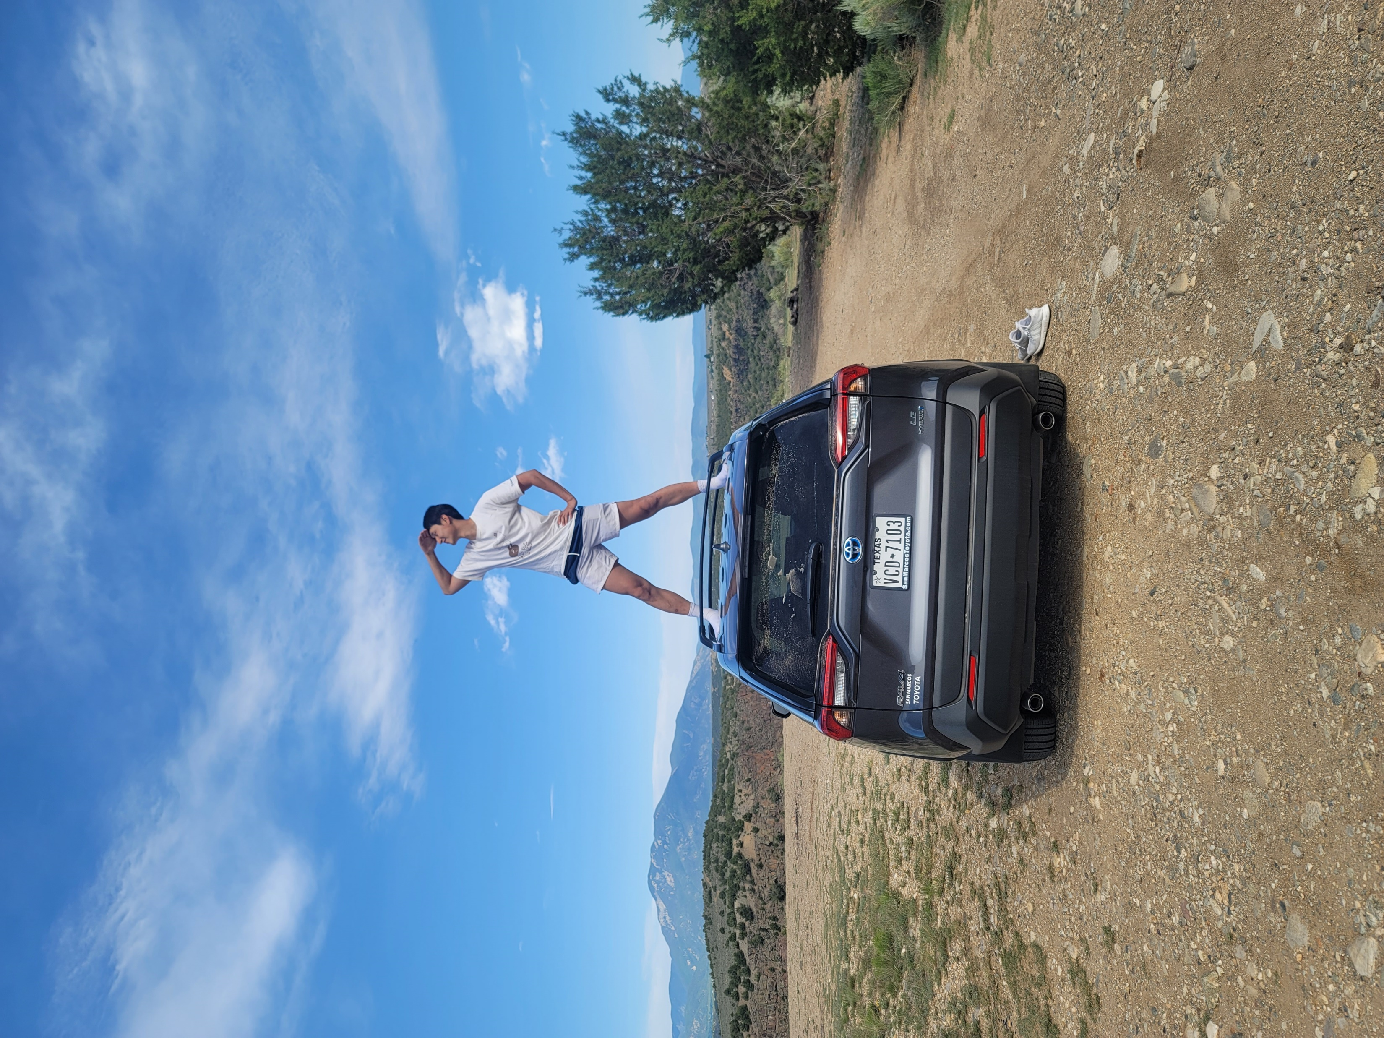
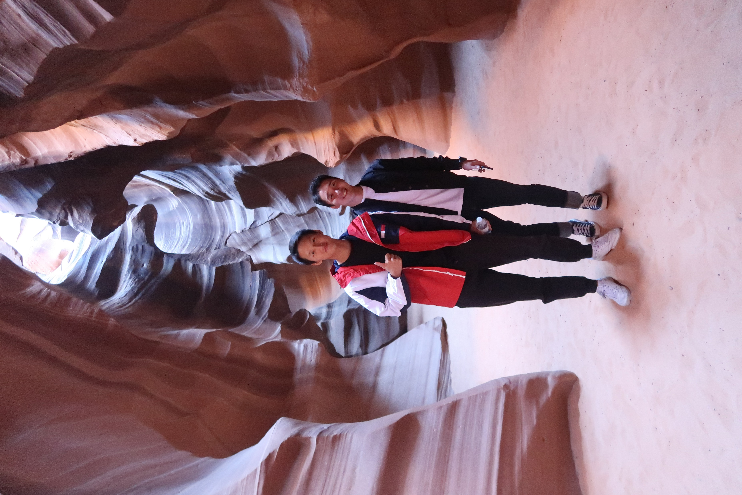
Introduction
Name: Bonsuck Koo
School: University of Texas at Austin
Degree: Integrated Master and Bachelor of Science in Mechanical Engineering (2024 Dec.)
Hobbies: Visiting National Parks
Obtained American Citizenship in July 2023
Notes:
MY name is Bonsuck Koo. And I am here to interview for the GNC engineer (early career) position. I am going to do my best to present myself to you guys.
I am a student at the university of Texas at Austin. And I have one semester left until I get my degree in Integrated Masters and Bachnelors of science in Mechanical Engineering. Lately, my hobbies have been visiting national parks or go on a hike on a weekend. I have gone to Grand canyon, Glen canyon for horse shoe bend, antelop canyon. And recently I have been trying to go everyweekend in New Mexico. The most amazing I have seen so far this summer was White sands national park. Just watching the beauty and scales of things in nature, it leaves me in awe and humbles me, so I like to look at them and visit them. I hope MAYbe one day I could see the Earth from space too, that would be the best thing I could see in my life I think.
I didn’t have a car and was biking in Seattle while I was there last year some of you might remember. So I didn’t get to go as much as hikes in Washington as I wished, but If I today goes well, I hope to visit a lot of places in Washington and get recommendations from you guys.
Also I obtained my American Citizenship in July 2023, I want to thank my parents for all that, so I could work in the Space industry without much restriction!

Slide 3
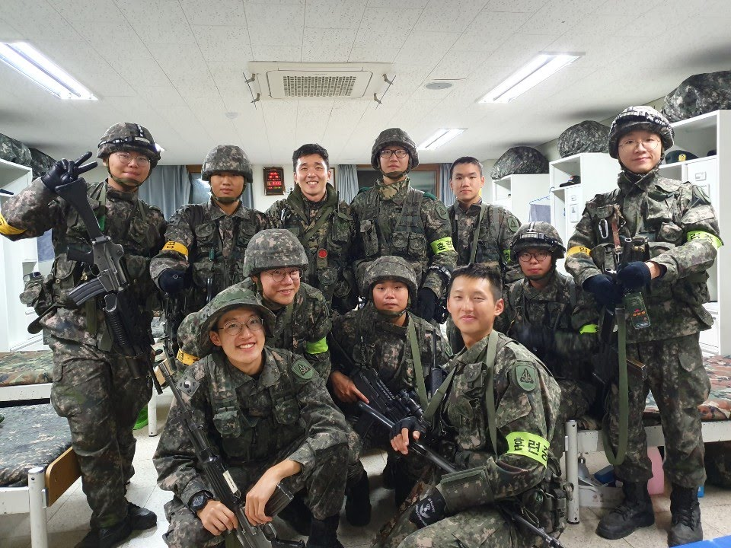
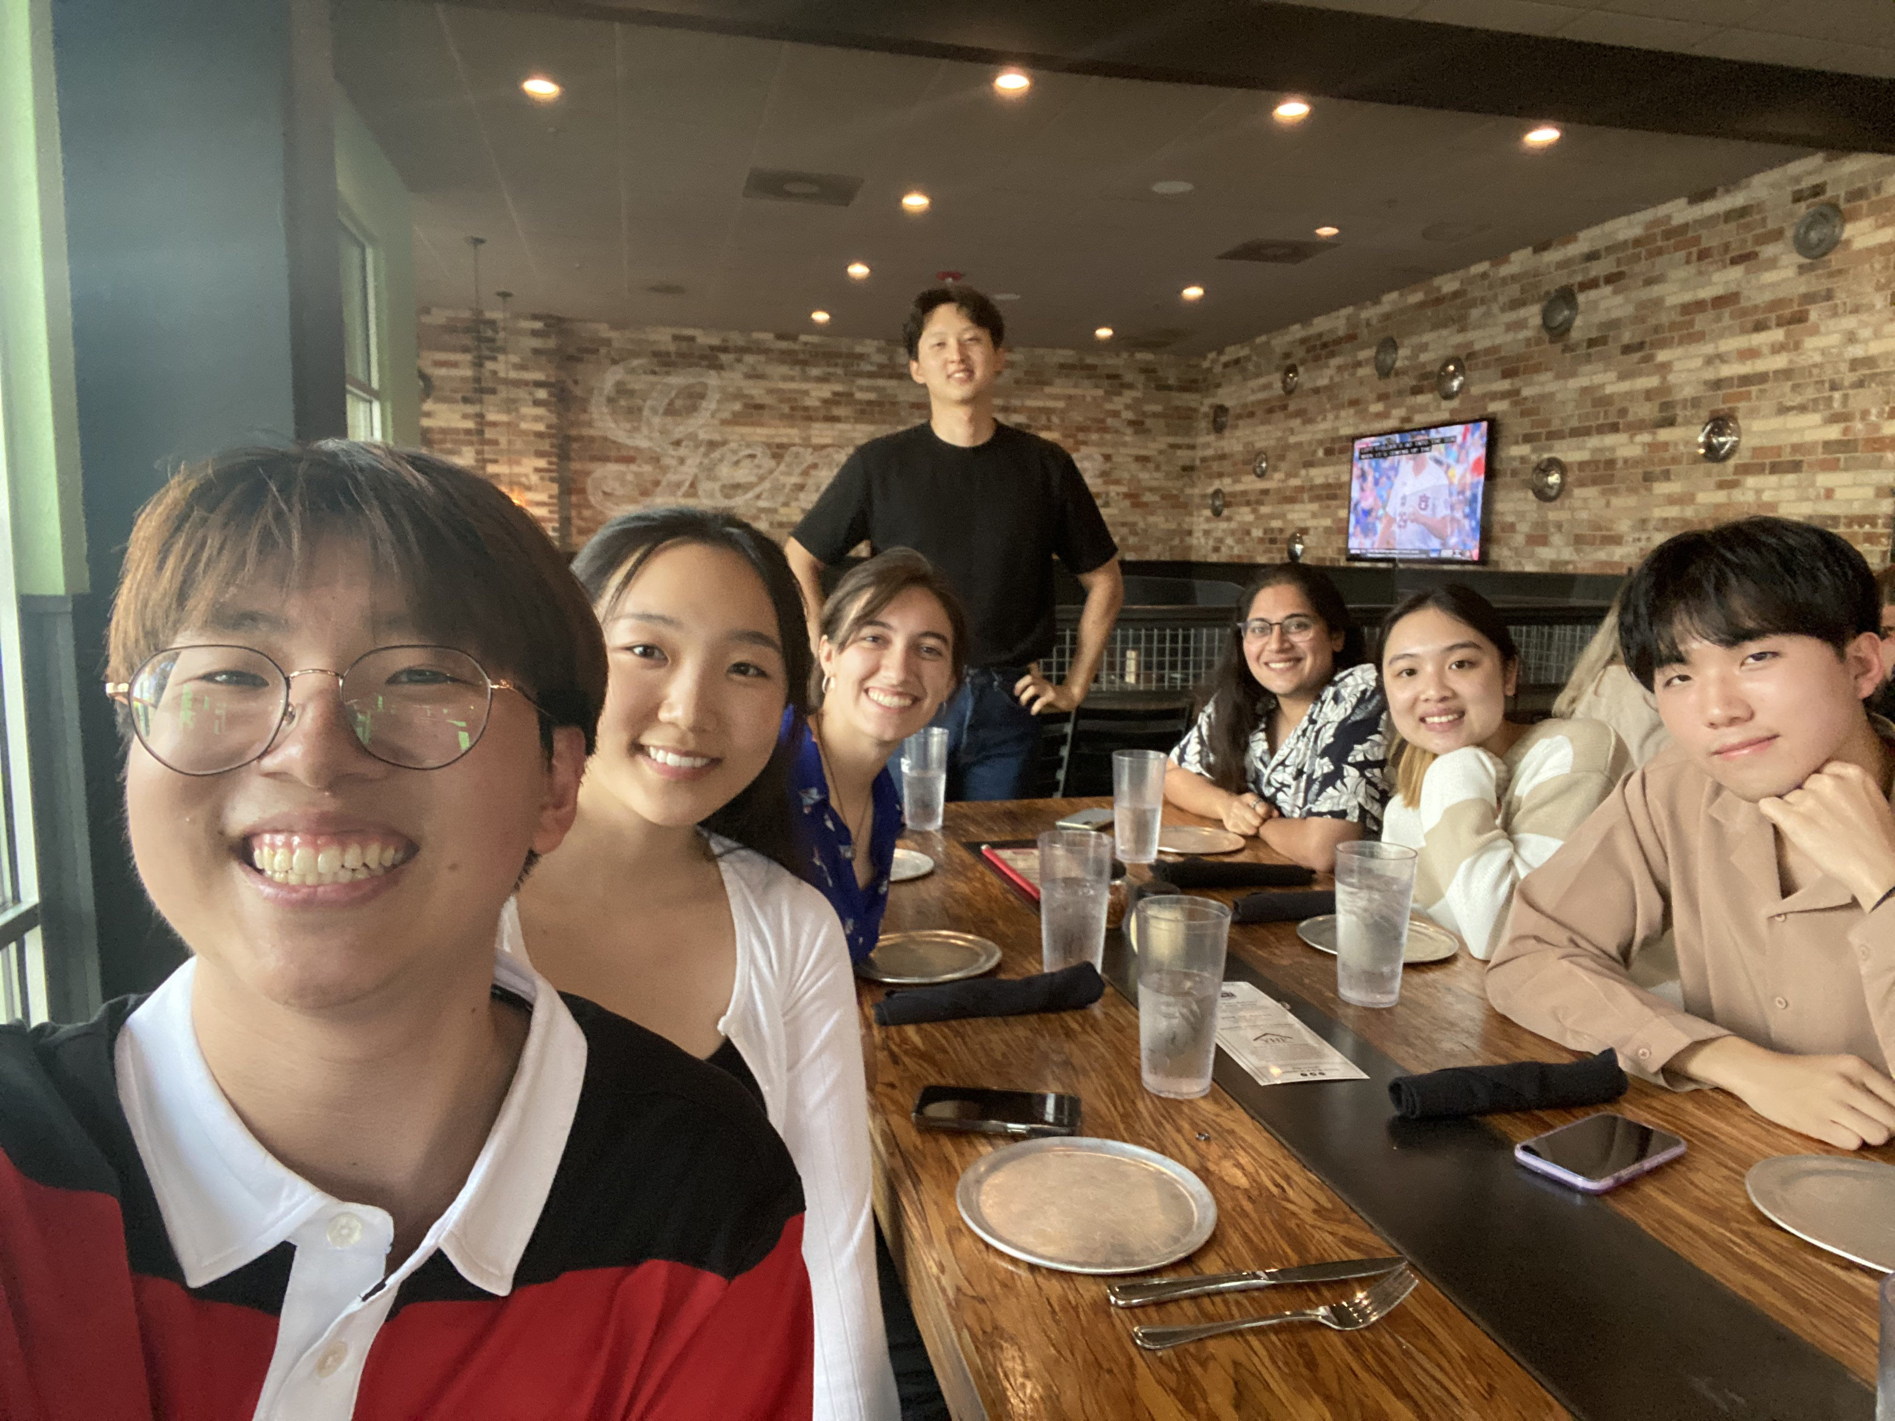
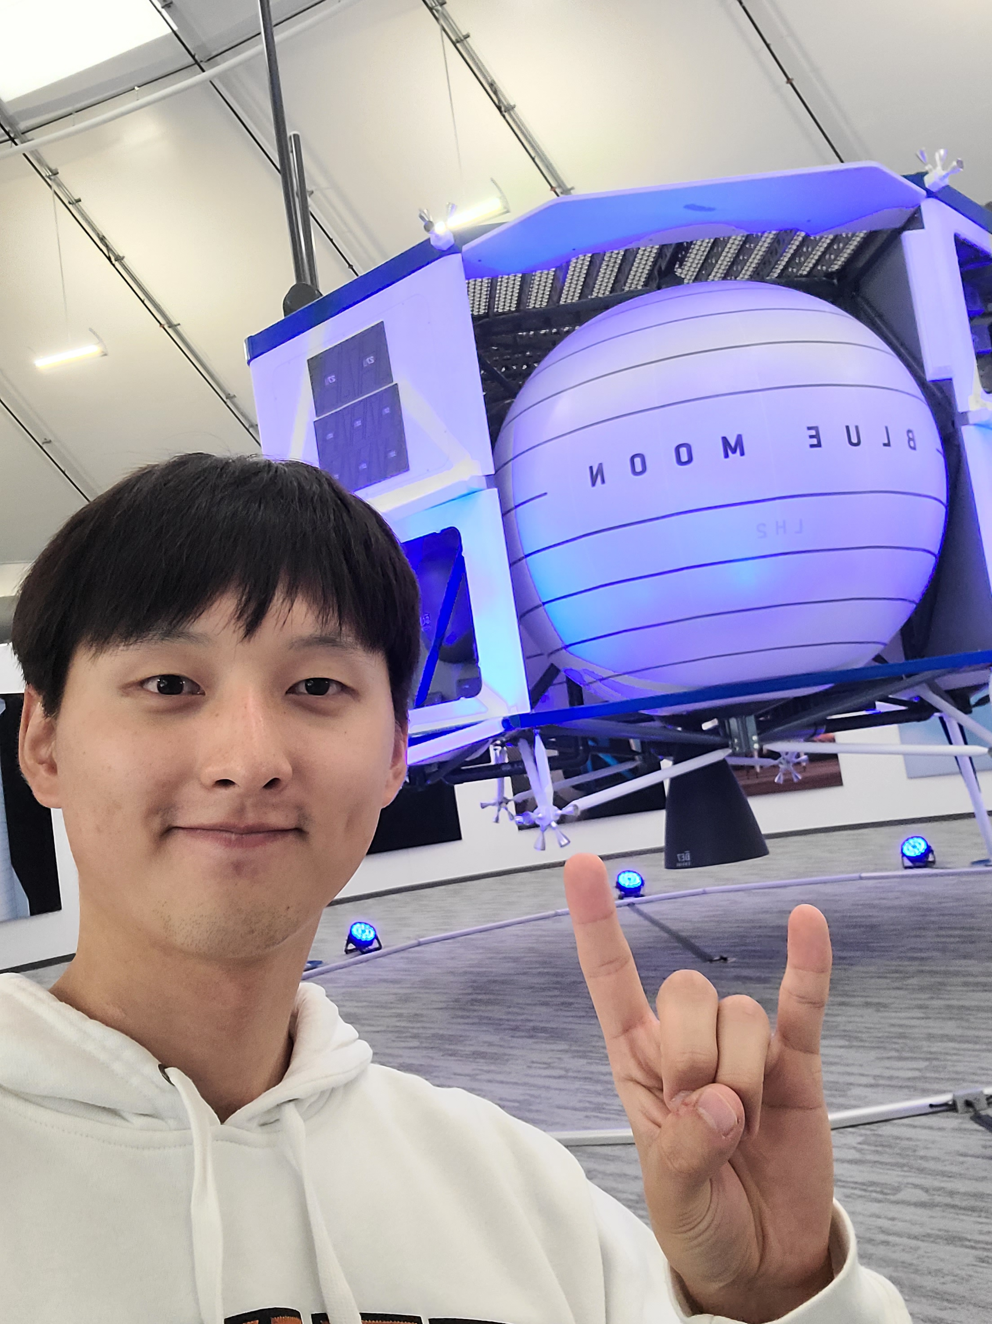
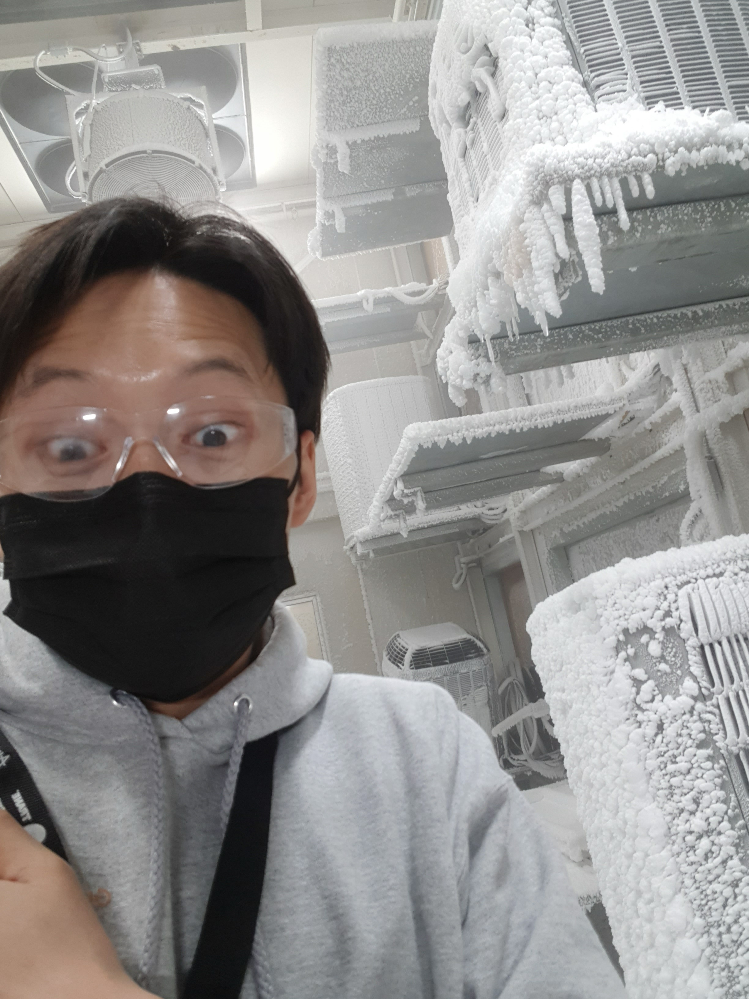
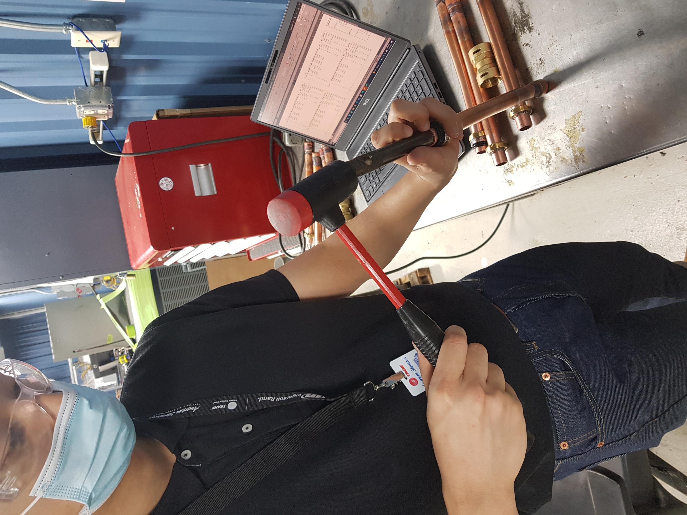
Experience overview
NGC engineering internship Sandia National Laboratories (Current)
GNC engineering Internship at Blue Origin (2023 Fall)
Mechanical Engineering Internship at Samsung Austin Semiconductors (2022 Summer)
Co-op at Trane Technologies (2021 Summer and Fall)
Mandatory Korean Military service (2018-2020)
Notes:
I am currently working as NGC or GNC eningeering summer intern at Sandia National Laboratories. I am doing almost exactly the same thing I had done at Blue, which was working with MATLAB and Simulkink Simulation of a flight vehicle.
Before that I worked at Blue as a GNC engineering intern in the New Shepard team in 2023 Fall as you guys know. There is a picture of me infornt of the moon lander.
In 2022 Summer, I worked at Samsung Austin Semiconductors, working on projects to facilitate technician’s work process. Although I was hired as a mechanical engineering intern, I was given a computer science task. I have never created a website before, I had no experience with JAVA, HTML, CSS, and SQL. But I learned in for two months during internship, and at the end I was able to create a website and excel VBA tool for the tehcnicians that saved 1 hour for the tehcnicans every shift. Although this experience here doesn’t directly match with the requirements for GNC engineering, but I like to at least briefly mention this internship because it displays my grit. Despite being thrown into a completely unexpected work and something I had no experience in, I appreciated that I got a chance to learn these new languages and did my best to produce a product. And I did deliver something for the team at the end. I am proud of that and I think it also aligns with one of the Blue’s leadership principle: “Deliver Results” ,which states that leaders show grit despite adversaries and barriers to deliver a quality result in time. That one is a picture at a lunch with interns friends at Samsung
And before Samsung my first internship was at Trane Technologies, an HVAC company, and I worked to improve technician’s work process there as well. I was working with copper pipes and trying to qualify a new component for AC and heating installation machines like the picture you see there. The last picture is a weather control room at Trane. Tha t room goes through four seasons in such a short amount of time. I think it goes through the cycle in only about two weeks. It snows, gets hot and rains to emulate the weather conditions outside, my component was getting tested in that room so I went in to go check I thought that was really cool so I put that picture.
Lastly, I did a mandatory military service in Korea from 2018 to 2020 when I still had the Korean citizenship, I just wanted put that there to explain my gap in education during those years.

Slide 4
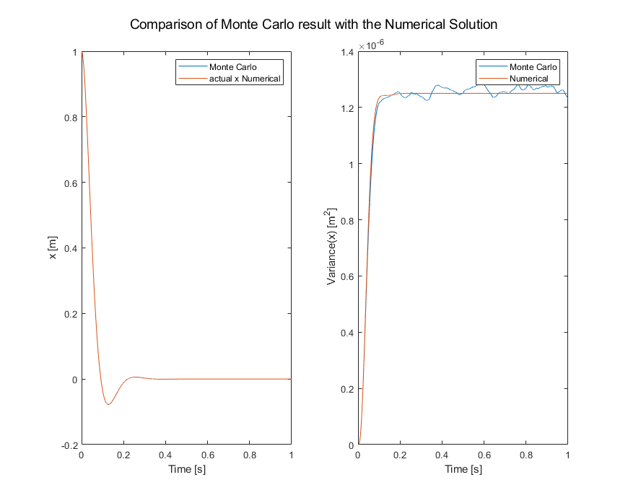
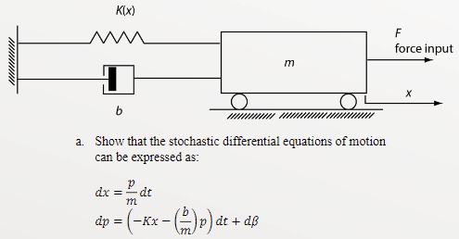
Experience overview
Relevant Courses:
Automated Control Systems
Dynamic Systems and Control
Spacecraft Dynamics
Stochastic Estimation and control
Aerial Robotics
Notes:
Also, in school overall, I have bneen taking control courses that allowed me to get a solid knowledge on the classical control concepts, and modeling of dynamic systems.
In the automated Control systems and Dynamic Systems and Control course, I learned how to model relatively simple systems using Bond graphs and representing them in State-space form. I would convert them into transfer functions and analyze them for Controllability and observability. I learned to use root locus plots to check its stability and choose specific controller gains to make the system stable. Lastly, I also learned to use bode plots to analyze for the systems stability through gain marigns and phase margins. The systems I dealt with in those courses were linear systems, and if they were nonlinear it was linearzed to analyze them with classical control method concepts.
And also after working at blue last year, I felt the need to take aerospace course to become more familiar with aerospace terms and concepts Also the MC analysis I saw it getting used alot, so the following semeseter I took Spacecraft dynamics in which I learned calssiclas orbit detmerination concepts. In Stochastic Estimation and control course, I got the chance to implement different Kalman filters like the kalaman filter for a linea system, unscented kalaman filter and extended kalmaan filter for nonlinear systems. Also, I got to run MC analysis for the same system as well. The system was a simple cart with a spring and a damper attached to it.
And the graph shows the the comapripson of Monte Carlo result with the numberical solution of that system with a certain initial state.
Aerial robotics course I will talk in much more detail soon.

Slide 5



Why Blue Origin?
Notes:
I want to join Blue because it shares my professional goa, which is to benefit our entire society. In my previous internships, the magnitude of impact that I realized an engineer could have and the apperication I received for helping technicians was so rewarding that I wanted to seek bigger work that benefit a greater society. I believe the best way to do so for me is by facilitating space travel. Because of global warming, I sincerely believe we have to reach out to space to find new resoiurces and new habitat. Also, I love nature, I like seeing them as I said before. I want all my families to see it, my friends to see it, and all the future generation to see what I saw. I don’t want Earth to change, I want to conserve it. Putting my effort into it wil help everyone in the world.
That’s exactly the mission Blue Origin has. Blue distinghishes itself from all the other space companies in that aspect. It emphasizes the bnefit of Earth rather than pure exicitement of spce exploration.
And As one of the Blue’s leadership principle, which is “Passion for our Mission”, as that principle explains, it is the Mission or the goal in our career or life, that motivates and drives people to put efforts to and produce results., so I think it’s important for both the company and myself to have that common goal to produce anything meaningful.
And I can contribute to that effort with my knowledge in GNC engineering. My master’s emphasis is in constorls and aerospace, and my courses and internship experiences has been geared towards it.
In addition, I understand Blue has a very supportive environment. While I was there last year, my mentor Phil, was always hands on and guiding me through my project. I learned a lot from him regarding using MALTAB simuloink especially GIT, Also with Tony he was always responsive to any questions I had, I felt comfortable asking him to do a 1on1s and ask for any guidance. Of course I think Jeff and Ethan in office created a very comfortable and fun environment in office, and also they were always open to me asking questions and having 1 on1s. I really like that supportive environment. Besides that the people in HR, Sara Ralaeigh and Chad here were all helpful and sometimes I felt they were truly tring to help me advance in my career.
I wante to be part of all that again and I hope today’s presentation could qualify me for it.

Slide 6
Projects
Aerial Robotics (Drone)

Slide 7
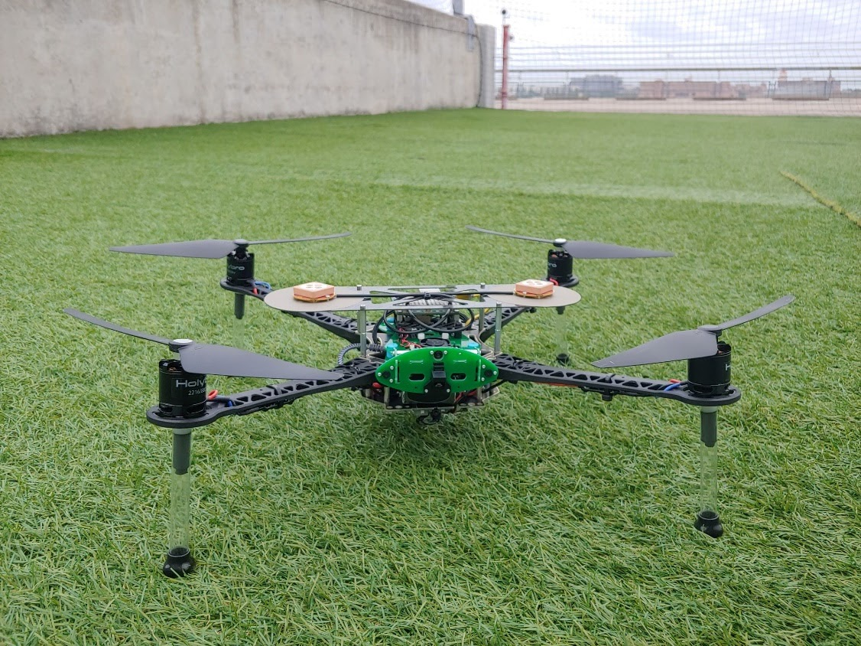
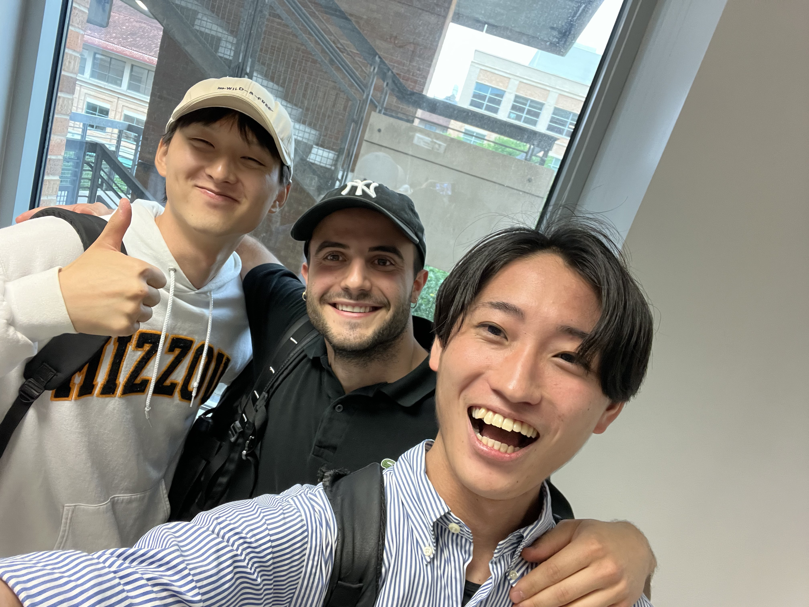
Aerial Robotics (Drone)
2024 Spring (Last Semester)
Team Competition
Team: Three people
Goal:
Create an algorithm to find the fastest routes to the targets
Targets were ballons in a field
Overcome obstacles
The algorithm should work both in simulation and real-life
Each Team was timed on how fast it pops two ballons from a designated starting point and returns to another designated end point.
One of the two teams that successfully flew the drone
2nd Place in class
Source: ASE 497W Todd E. Humphreys; University of Texas at Austin
Notes:
The first project I want to present is the Drone project I did in Aerial Robotics course last semester. This was a team competition that consisted of three people per team. The goal was to create an algorithm for the drone that would find the fastest routes to targets. The targets were balloons placed on a field, which you will see soon. And the drone had to pop the balloons by flying through them to confirm that it reached the targets. There were also imaginary obstacles that the drone had to go around,and lastly the algorithm should have worked both in a simulation environment and in real life.
So for the competition, each team would timed on how fast it pops two ballons from a designated starting point and returns to another desginated end point.
Here you see a picture of the drone, or the quadrotor that we implemented our algorithm on. Here is a picture of my proud teammates!
For spoilers, We were one of the two teams that successfully flew the dorne in real life and ended up placing 2nd in the competition.
Before I begin explaining my work, I will start by showing the result of my team’s work together!

Slide 8
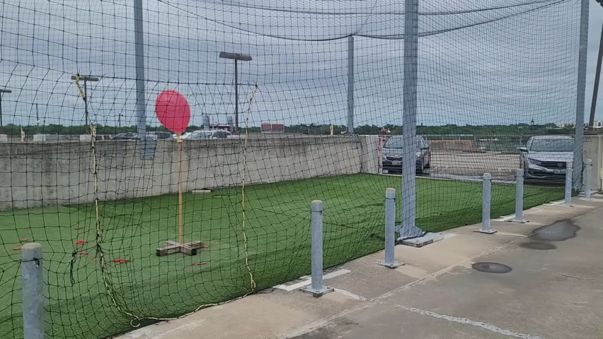
Notes:
So what you see here is the field, which was just a netted area on top of the school’s parking garage. The drone is flying inside the netted area and moves itself towards the ballons. Here you see that it manuevers towards the ground, and that’s because there is an imaginary wall, so it had to go below the wall. There are other imaginary obstacles in this field. And you see that it tries to return to an ending spot by going around obstacles again.

Slide 9
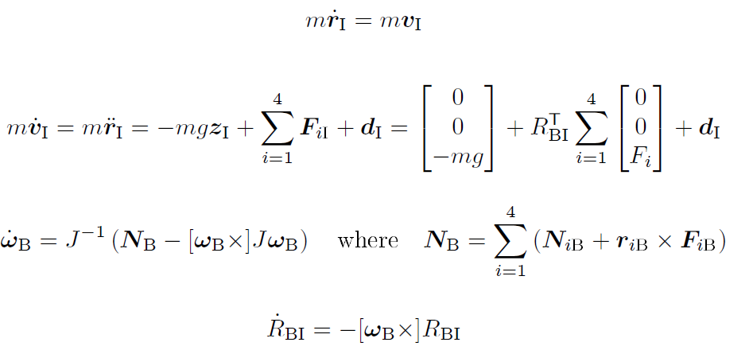

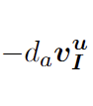
Aerial Robotics (Drone) Quadrotor Dynamics
Disturbance
Force from the Fan
Gravity
Wind Resistance
Torque from propeller acting against the air
Torque from upward thrust
Source: ASE 497W Todd E. Humphreys; University of Texas at Austin
Notes:
So, before we actually worked on the algorithm to do all that, Each of us first developed a simulation that would simulate the Drone’s flight behaviors on MATLAB.
I first modeled the drone’s dynamics with 4 ODE.
The first equation was the velocity, which is just defined here.
The dynamic equation for the acceleration was determined by the forces acting on the drone. Here is the gravity acting on the drone. The second term is the upward force exerted by the fan onto the quad which keeps the drone up in the air, and we have four of those. We have the drag force acting against the motion of the quad at the end. Lastly, any disturbance force was modeled as a noise.
The third equation is for the angular acceleration. This is what you get if you take the derivative of angular velocity. Nb term is the torque combination caused by the propellers. Specifically, NB_i is the torque caused by the propeller acting against the air, so it makes the drone spin on its own axis, like this. The R cross F term is the torque caused by the thrust force that keeps the drone in air, which could make the quad flip over.
Lastly, I have the equation for the change in the attitude matrix. Notice I used the full rotation matrix to avoid singularities or gimbal lock, instead of Euler angles.

Slide 10
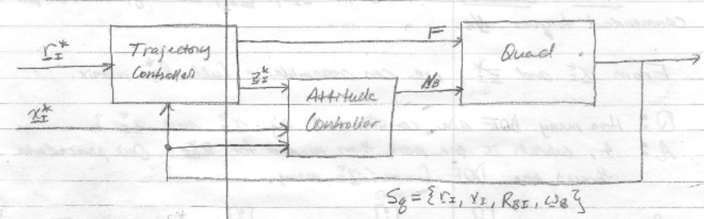
Aerial Robotics (Drone) PD controller
PD Controller
Plant
Reference or desired states are denoted with a star
Source: ASE 497W Todd E. Humphreys; University of Texas at Austin
Notes:
Here is the schematic of the control system I was simulating for. I used two controllers, one for trajectory control and another for an attitude control. PD controllers were implemented for both.
R star is the position of the drone, x star is the position of the x-axis of the drone’s body frame.

Slide 11
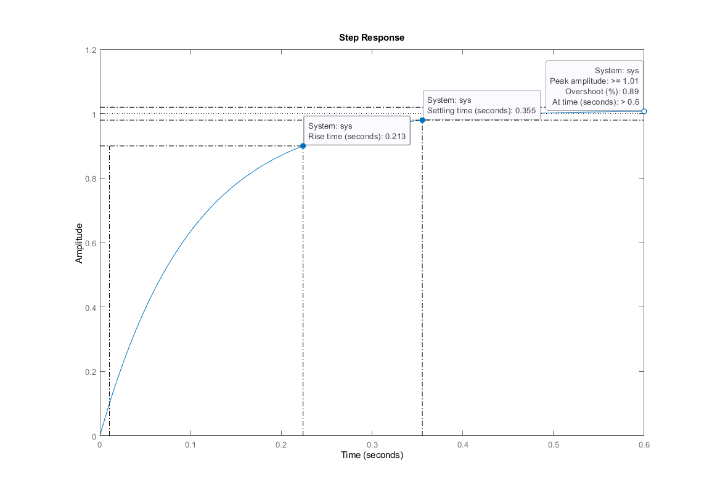
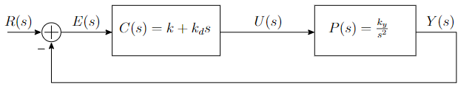
Aerial Robotics (Drone) PD controller
Notes:
But Before actually implementing PD controllers, a basic PD controller in this figure for this systmem was tuned to see how P and D gains affect the system behavior.
The goal of this exercise was to make the closed loop system’s unit step response to have less than 0.25 seconds
of rise time (Tr), less than 30 % of over shoot (Po), and less than 2 seconds of settling time (Ts) to within 2 % of reference value. .This figure shows the step response of the closed loop system with the a specific gains I chose.
Talk about how does PD affects the behavior*******************
Increasing P gain generally increases the speed of response say the reduce rise time and also reduces the setlting time.
The D gain generally decreases overshoot, but also makes it more sensitive to noise and errors.

Slide 12
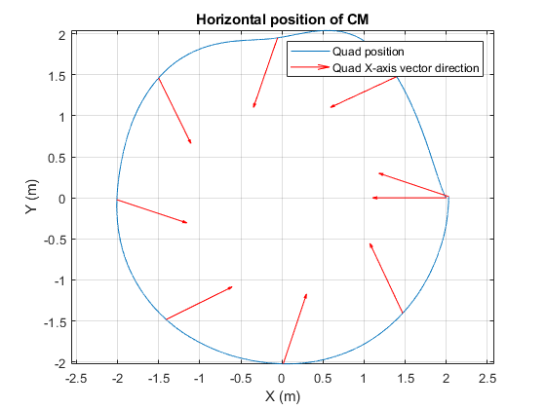
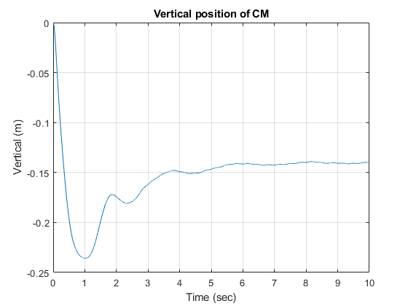
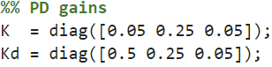
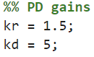
Aerial Robotics (Drone) PD controller
Attitude Controller PD Gains
Trajectory Controller PD Gains
Notes:
For The actual tuning of attitude controller was really hard, because P and D gains were in matrix form for the attiude. I tuned it until the drone followed a desired circular and a designated height as closely as possible in a MATLAB simulation. Also I wanted the quad’s front to face the center of the circle throughout the flight.
In the left figure, you see the trajectory of the drone in the simulation as a blue line. It isn’t a perfect circle, but it kind of looks like a circle. The red arrows show you the direction of the quad’s “x-axis” or I can say the front of the quad. We see that mostly, it is facing towards the center of the circle. In the right figure, the goal was to get the drone to fly at 0 m, but I got as close as 0.15 m.

Slide 13
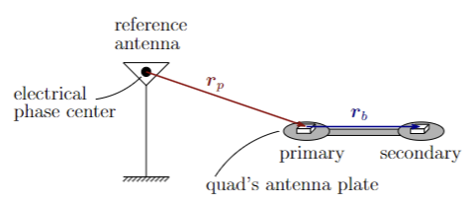
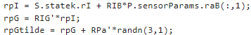
Aerial Robotics (Drone) Sensor Modeling
GNSS Measurements
Source: ASE 497W Todd E. Humphreys; University of Texas at Austin
Source: ASE 497W Todd E. Humphreys; University of Texas at Austin
Notes:
We also modeled Measurements from the GNSS antennas to find the position of the quad.
Here is the schematic of the GNSS antennas. There is one big reference antenna in the field, acting as an inertial reference frame. Although it actually is not inertial, since it is rotating with the Earth, but the inertial sensor isn’t sophisiticated enough to know that, so I was able to assume that it is inertial.
And two additional antennas are attached to the drone at its center.
So in reality and if the drone was flying and receiving GNSS measurements, the actual drone would receive according to this diagram. The position of the primary antenna in reference to the fixed antenna, rp, and also the position of the secondary antenna in reference to the primary antenna, rb
This measurement was emulated in the MATLAB simulation by taking the current actual position of the drone, adding antenna locations on the drone, and adding some noise.

Slide 14
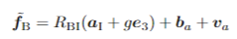

Aerial Robotics (Drone) Sensor Modeling
IMU
Accelerometer Measurement Model
Rate Gyro Measurement Model
Accelerometer
Bias
Acceleration
Gravity
Accelerometer Noise
Gyro Bias
Gyro Noise
Angular Velocity
Notes:
Here is the eqeuation of model for IMU measurments. The accelerometer measurement accounts for the accleartion of itself, gravity and the bias noted as ba and noise Va.
The accleartion term is defined in the equation below, the regular asccleartion equation lot of you know, but for this, I assumed the origin of the acclearomter was fixed to the origin of the Body, which cancles out these terms.
So essentially this FB bar omega b bar equation is what defined the IMU model.

Slide 15
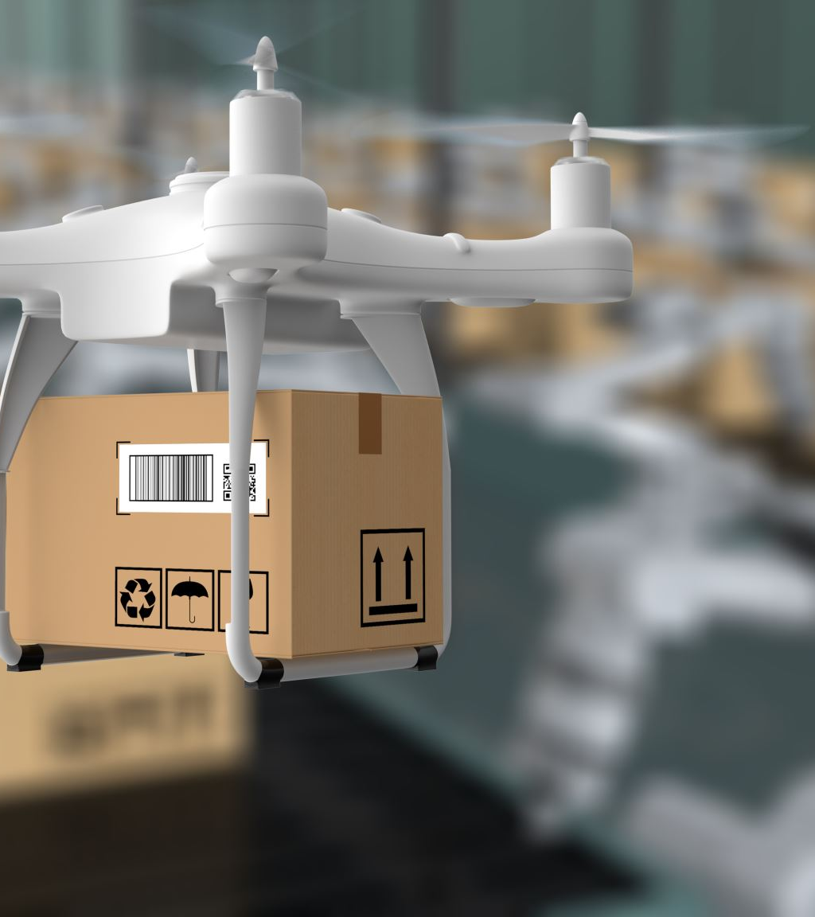
Aerial Robotics (Drone)
Additional Modeling
Camera
Unscented Kalman Filter
Full MATLAB simulation
Goal:
Follow reference trajectory
Determined by A* algorithm in C++
Maintain 0 m altitude
Notes:
Lastly, additional modleing and tool I used to complete the simulation were the camera model to detect the ballons, and the unscented Kalment filter on MATLAB that my professor provided for us for better state estimates.
With all of these models, I simulated how well the drone achieves the goal in the simulation environment, which is to follow the reference trajectory and maintain 0m altitude. In the next slide you will see the result of the MATLAB simulation I ran, and the reference trajectory I fed into it was a path determined by an algorithm that uses A* method I developed in C++, which I will explain more later.

Slide 16
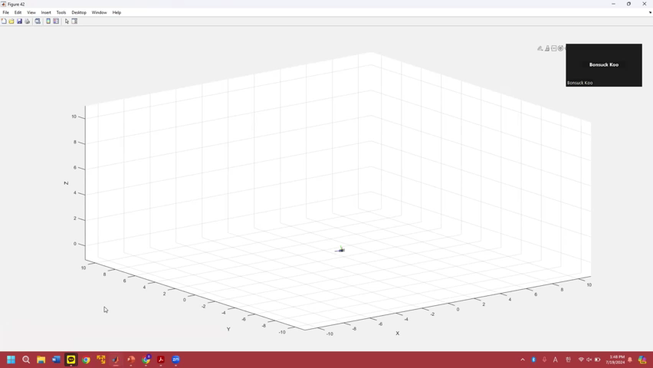
Aerial Robotics (Drone) Completed MATLAB Simulation
Notes:
You see here that the drone fooloows a certain trajectory and the x-axis or the red line always points towards the direction of travel of the drone.
After seeing the controllers working well in the simulation, I now moved on to implementing a path finding algorithm on C++

Slide 17
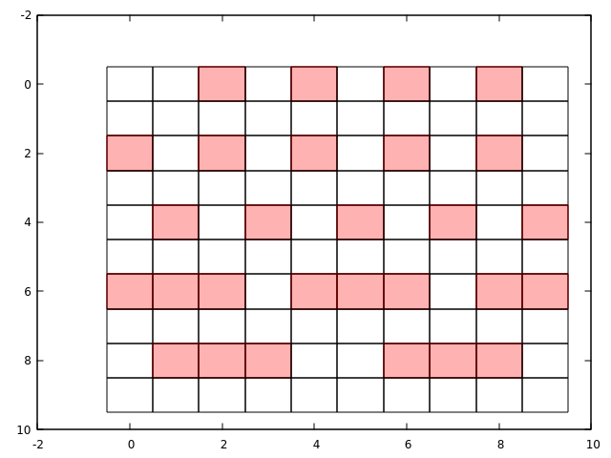
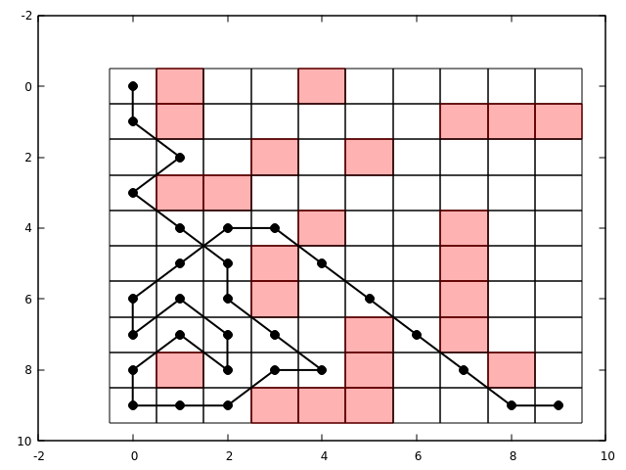
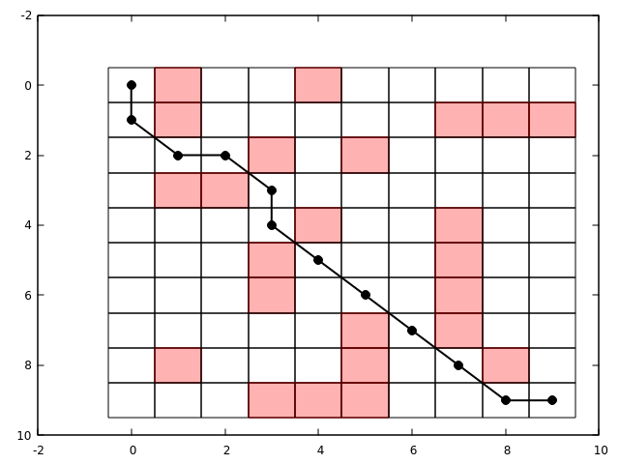

Aerial Robotics (Drone) C++: Path Finding Algorithm
Comparison of three different path finding algorithms in C++
Selection Criteria:
Number of Nodes Explored
Number of Nodes in path
A field gridded into cells and mapped into nodes. Nodes are at the center of each cell. Red cells represent obstacles.
START
END
Depth First Search (DFS)
Dijkstra’s
A*
Notes:
There were three options I considered. Depth First Serach DFS, Dijkstra’s algorithm and A* method.
How I chose one algorithm to implement was based the two criterias.
The number of nodes explored, number of nodes in path. If I explain what the picture on all the way to the right is, I think it will help understand the first criteria.
Say a field can be gridded into cells and mapped into nodes. Like the picture you see all the way to the right. The nodes exists at the vcenter of each rectangular cells. The red cells represent obstacles that the drone cannot go to.
This sort of mapping of a field is what was provided for the actual competition. The professor gave us the 3D occupancy grid that represented the actual field that the drone flew on.
So for selecting an algorithm, I used a much smaller scale and simpler 2D occupancy grid that you are seeing right here on the top right.
So back to talking about the criteria. Starting with the first criteria, So the three algorithsm have different ways of selecting which cells or nodes should be explored or not. And sometimes that algorithm could explore multiple “incorrect path” before it finds the “correct path” or other times the algorithm is smart enough to weed out certain cells right away to find the “CORRECT” path instantly without exploring other “incorrect paths”. Definitely I should prefer the latter situation, so that’s what the first criteria measures.
For the second one, it’s a much simpler criteria, that is the determined path has to be the shortest possible way, since this competition is time sensitive. For example, say if both the DFS algorithm and A* algorithm explored the same number of nodes to find its path, but obviously I would choose A* because the path it found is much shorter than the one found by DFS.
So with those criteria and also clearly seen from these pictures,
I coded all of them in C++ and tested them in the 2D test occupancy grid
The A* method was the most efficient path finding algorithm that explores the lest number of nodes and had least number of nodes in path.
Now you will see how the C++ A* algorithm I worked on looks like in the game engine simulation I was provided to work with.

Slide 18
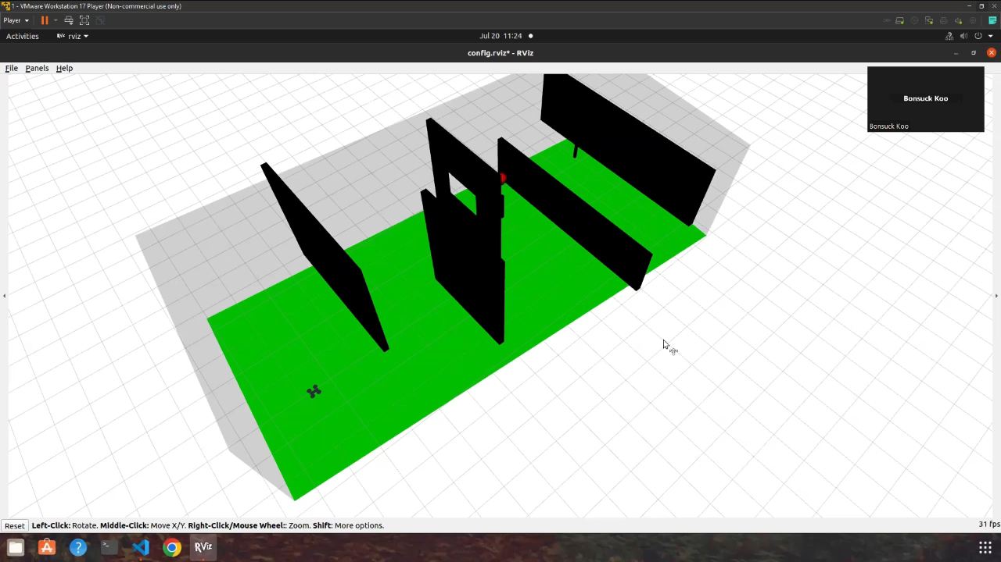
Aerial Robotics (Drone) C++: Path Finding Algorithm

Slide 19
Aerial Robotics (Drone) Team Collaboration
Communication and Feedback
GIT
Experience at Blue helped me lead the Team to utilize GitLab
Notes:
At the end, of course this competition was a team effort, and I could not have completed this project without my teammates.
The best part about having teammates is getting help from each other. When I was struggling with my part of work, my teammates had conversations with me about the relevant topics or concepts that my code pertained too. And while talking to them I would notice errors to my code. Or sometimes they would simply look at it and notice small bugs as a third person, which I didn’t notice at all by myself. We would also talk to each other give feedback to how certain codes can be better implemented, each of us would incorporate that.
I really like that and I knew the feedback would help the team, so at the beginning of this team project, I told my teammates that our team should try to communicate with each other as often as possible whether that’s text, zoom meetings or in-person meetings, so that we all will be comfortable with each other and exchange feedback and not be afraid to get or give help to each other. Our response to that was having a in-person meeting at least twice a week, we would also talk after lectures, and I really like the meetings because since we are all in the same space giving feedback was much easier than sending a text or email. And also spending time together in person also pulled the team together to work with each other even more closely.
I think it worked really well and we got a good result because of it.
I also notice the idea of active communication and feedback is one of the Blue’s leadesrship principle, “Embrace Team Blue” so I wanted to point this out.
And a short side note, I contributed to the team with my experience in GIT. I am very thankful that I struggled with GIT at Blue for a few month while I was there. None of my teammates knew how to use Git at first, so I was able to help the team set up Git repository, help if any members had issues with Git. I was glad I could do that for the team.

Slide 20
Summary of Drone Project
Situation
A competition to pop the balloons with a drone in the least amount of time
Task
Develop MATLAB simulation
Develop path finding software for the drone
Action
Apply knowledge in dynamics, classical control theory, navigation sensors ( accelerometer, gyroscopes, GNSS receiver) for MATLAB simulation
Implemented A* method in C++ for path finding algorithm
Feedback through active Communication
Git to collaborate
Result
2nd place!
Notes:
I really wanted to point this project out, because this course really felt like the software development process through SIL at Blue. Though this one is much smaller scale but it was more hands on for me since I got to develop most of the simulation and implement C++ code myself. I think these skills are super for this GNC engineering Early Career position that requires knowledge in Dyanmics, classical control theory, MATLAB, C+++ , communicatation skills, etc.
I hope this explained why this experience helps me prove I will be a good for this position.

Slide 21
Projects
Senior Design Project

Slide 22
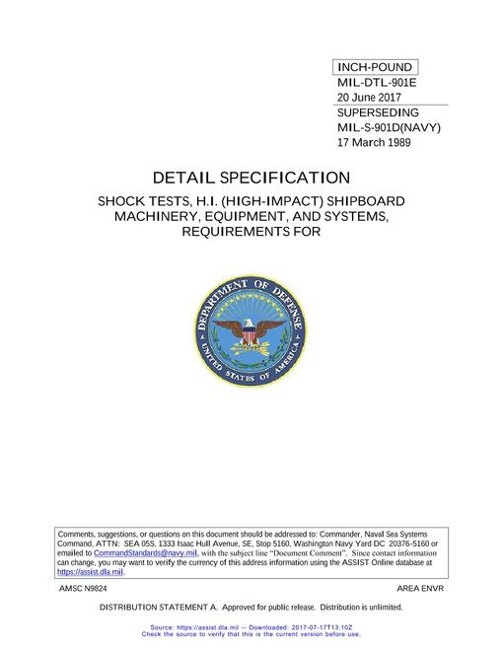
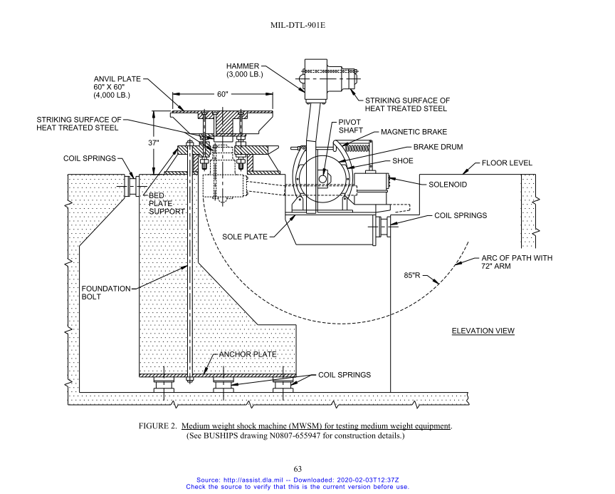
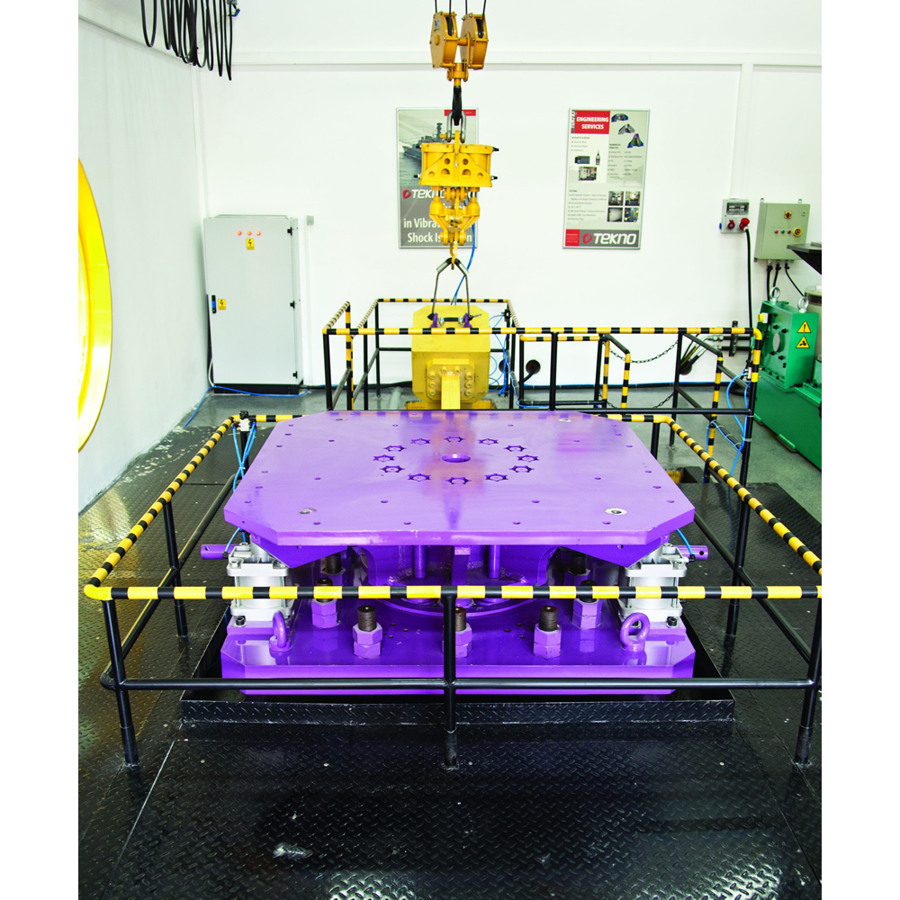
Senior Design Project Background
Team Lead
Sponsor: Southwest Research Institute (SwRI)
Design a high-impact test machine for equipment on naval ships
Comply with MIL-DTL-901E standard
Source: www.tekno-eta.com
Notes:
In the fall 2022, I was the team leader for my senior design project. Our sponsor Southwest Research Institute requested our team to design a high-impact shock test machine, and this machine is suppose to test whether naval ship equipments could withstand certain impacts according to MIL-DTL-901E standard. Here is the cover of the specification standard I had to read and a diagram that roughly delineates what a impact machine should look like. Basically an equipment sits on top of this anvil plate, and you see a hammer here and it swings around to hit the bottom of this anvil plate. That’s the test. Here is the actual picture of it in another company.
And this machine is suppose to be really big. Just the hammer should weigh 3000 lbs, it’s also taller than me which is about 6 ft, and this plate is 60 inches x 60 inches big.
SWRI wanted to build and have its own shock test machine.

Slide 23

Senior Design Project Defining the Problem
Hammer
Deliverable
CAD Model
Static Finite Element Analysis (FEA)
Confined project scope to 4 subsystems:
Brake
Hammer Lift
Mount
Notes:
In less than three months’ time, my team had to deliver a preliminary CAD design of the machine and a Static Finite Element Analysis (FEA) result. It was daunting at first to build such a big system in a relatively short amount of time. But I took the lead to plan our project together.
First, I wanted to define the scope of the project to a reasonable scale. The machine has multiple systems and components, and it was not plausible for four of us to design all the systems. During my team meeting, I brought up my concern, and my team and I came up with a proposal to design only of the four main critical systems on the machine: a Mounting System that fixes and holds the machine onto the floor, Braking System to stop the hammer after the impact, lifting system to lift the hammer, and impact system, or the hammer. We conveyed our opinion about the scope to our customer or the sponsoring engineers and were able to persuade them by explaining that given the time and the resources we have, it is best to focus on those four mechanical systems. It was critical that we did that because Not only did we have less than three months, each of us were taking other Mechanical Engineering courses, doing researches in their labs, and looking for a job while this project was going on. Our team agreed that the best way to be resourceful of our time and ability is to focus on specific systems, so we can deliver a quality result to our customer.
Having this discussion and coming up with a proposal with my teammates helped each of us feel the ownership for the project. During the discussion, it was each one of us who said that it is plausible for us to design the four systems given this time, it was us who agreed that we can deliver the results to our customers given these resources. Because we proposed to do them, I believe everyone in the team felt responsible and ownership of the tasks ahead of us.
So if I am in any other team projects, whether I am the lead or just a member, I like to clearly discuss the scope of the project and plan the project together to provide ownership of the project for everyone.

Slide 24
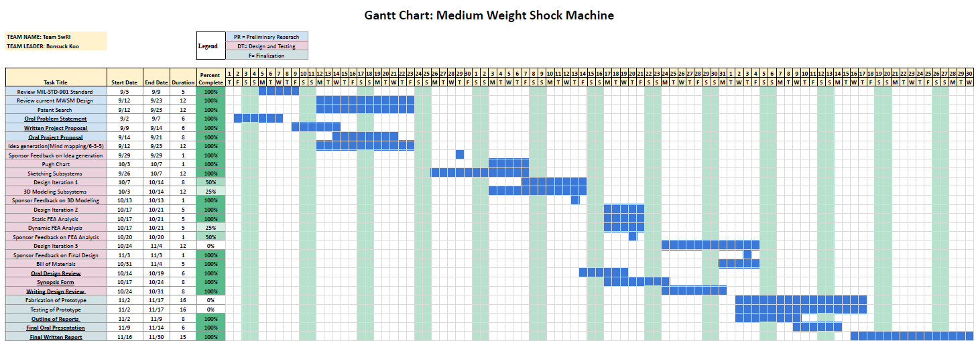
Senior Design Project Communication
Notes:
So far, I might have been giving the impression that we were too busy to do this project, but we were not. We instilled trust into the minds of our sponsor through planning and active communication.
Here is the project Gantt chart. It outlines the entire tasks and dates of when we are going to work on them.

Slide 25
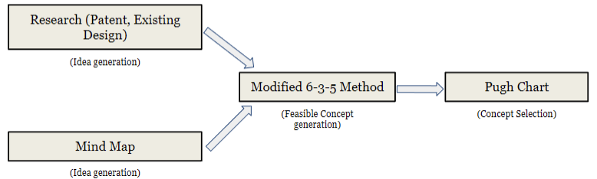
Senior Design Project Communication
Notes:
Here is a diagram explaining how we are going to brainstorm ideas, and select one idea to produce a CAD model for.

Slide 26
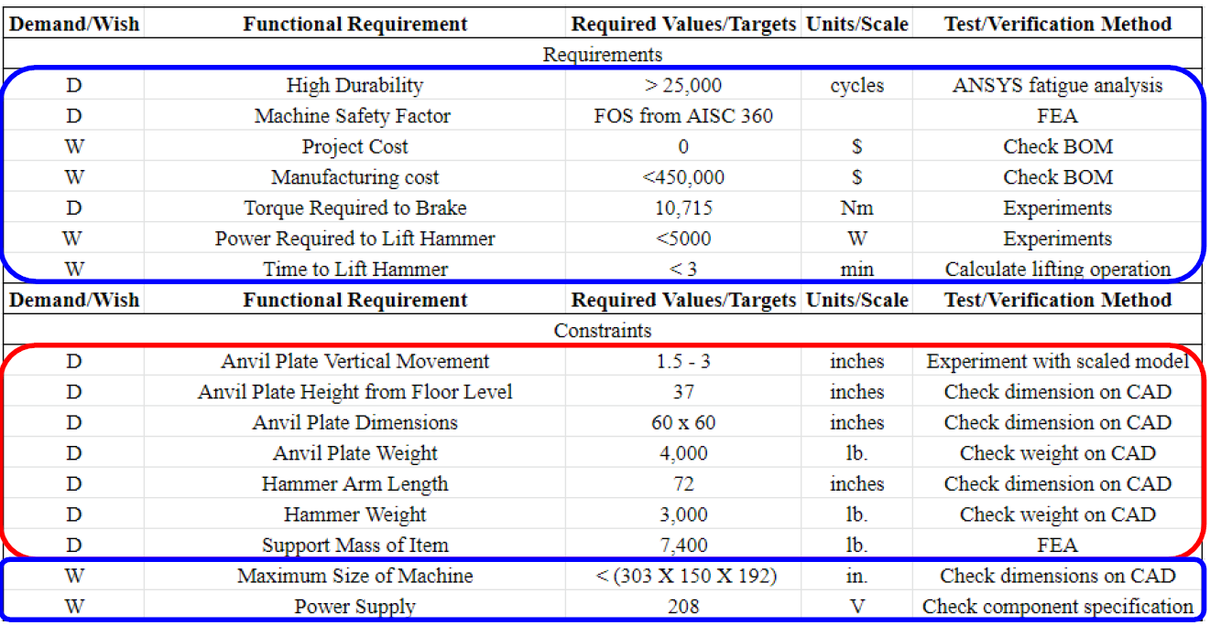
Senior Design Project Communication
Notes:
Here is the specification sheet of the machine that we created based on the requirements from the military standard and our sponsor’s demand.

Slide 27
Senior Design Project Communication
Communication with Sponsor
Trust
Show the team’s plan
Show our understanding of the project
Communication within the team
Action Items every meeting
Notes:
We showed those charts for our sponsors to have certain expectations at different times and to know what we are working on at different points throughout the semester.
And every week when we meet, we told them our progress, what worked and what didn’t work. Or sometimes, I would brief them about the summary of the military standard I read, and I would confirm my understanding with theirs.
So, It was important to show our understanding of the project as often as possible, so that the sponsor understands that we are going in the direction, and we are sure of what we are doing. One time, we were not sure how much force we should assume that the hammer and the anvil plate will experience. Our sponsoring engineer advised us to multiply the static force we caclualted by rthree for the analysis, since the three signam is the industry standard.
This kind of active communication, I believe allowed our sponsor to feel comfortable working with us and entrusted us to finish the project.

Slide 28
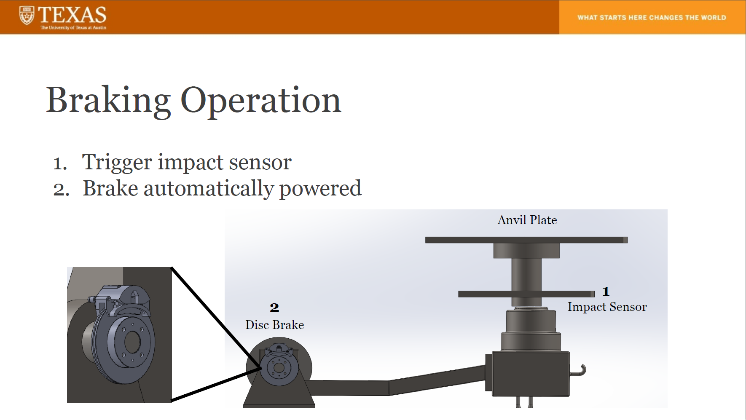
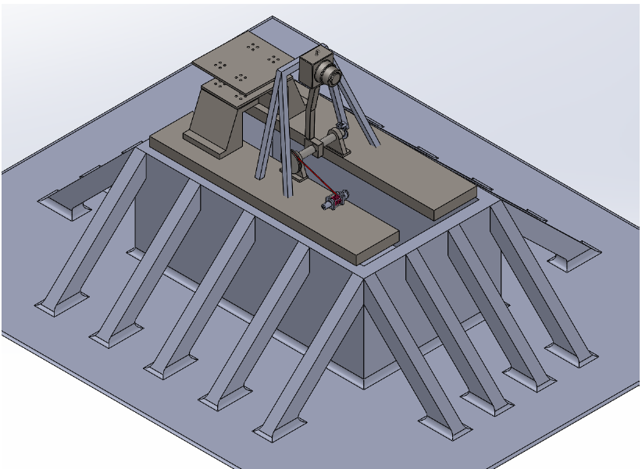
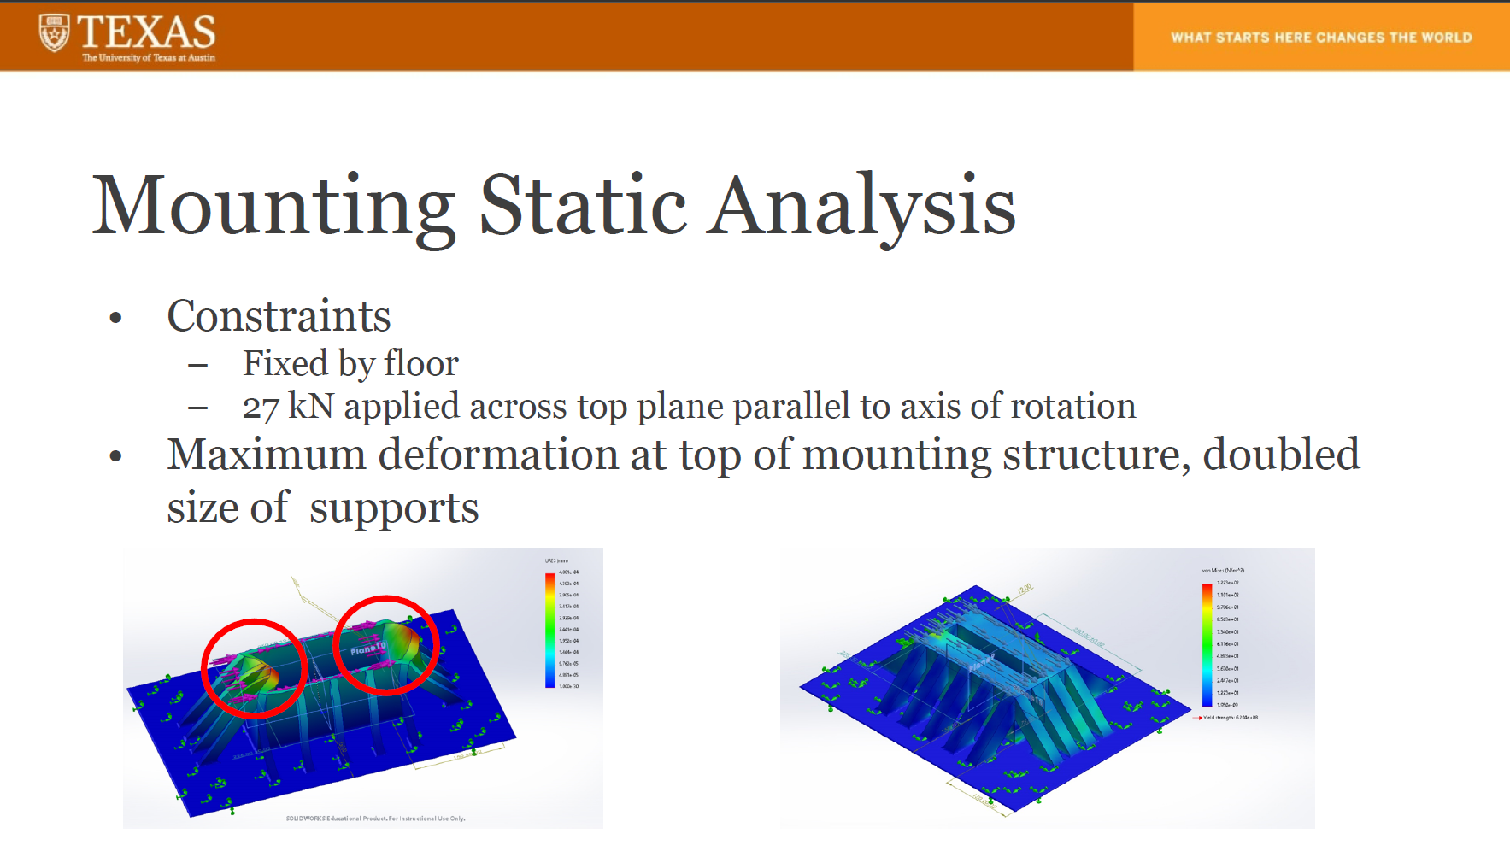
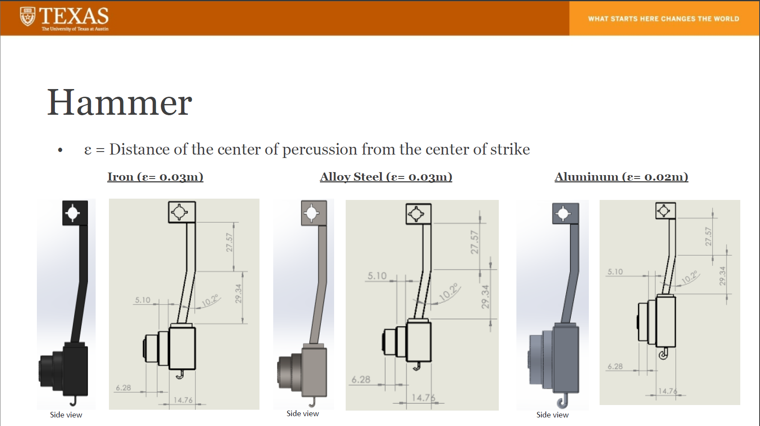
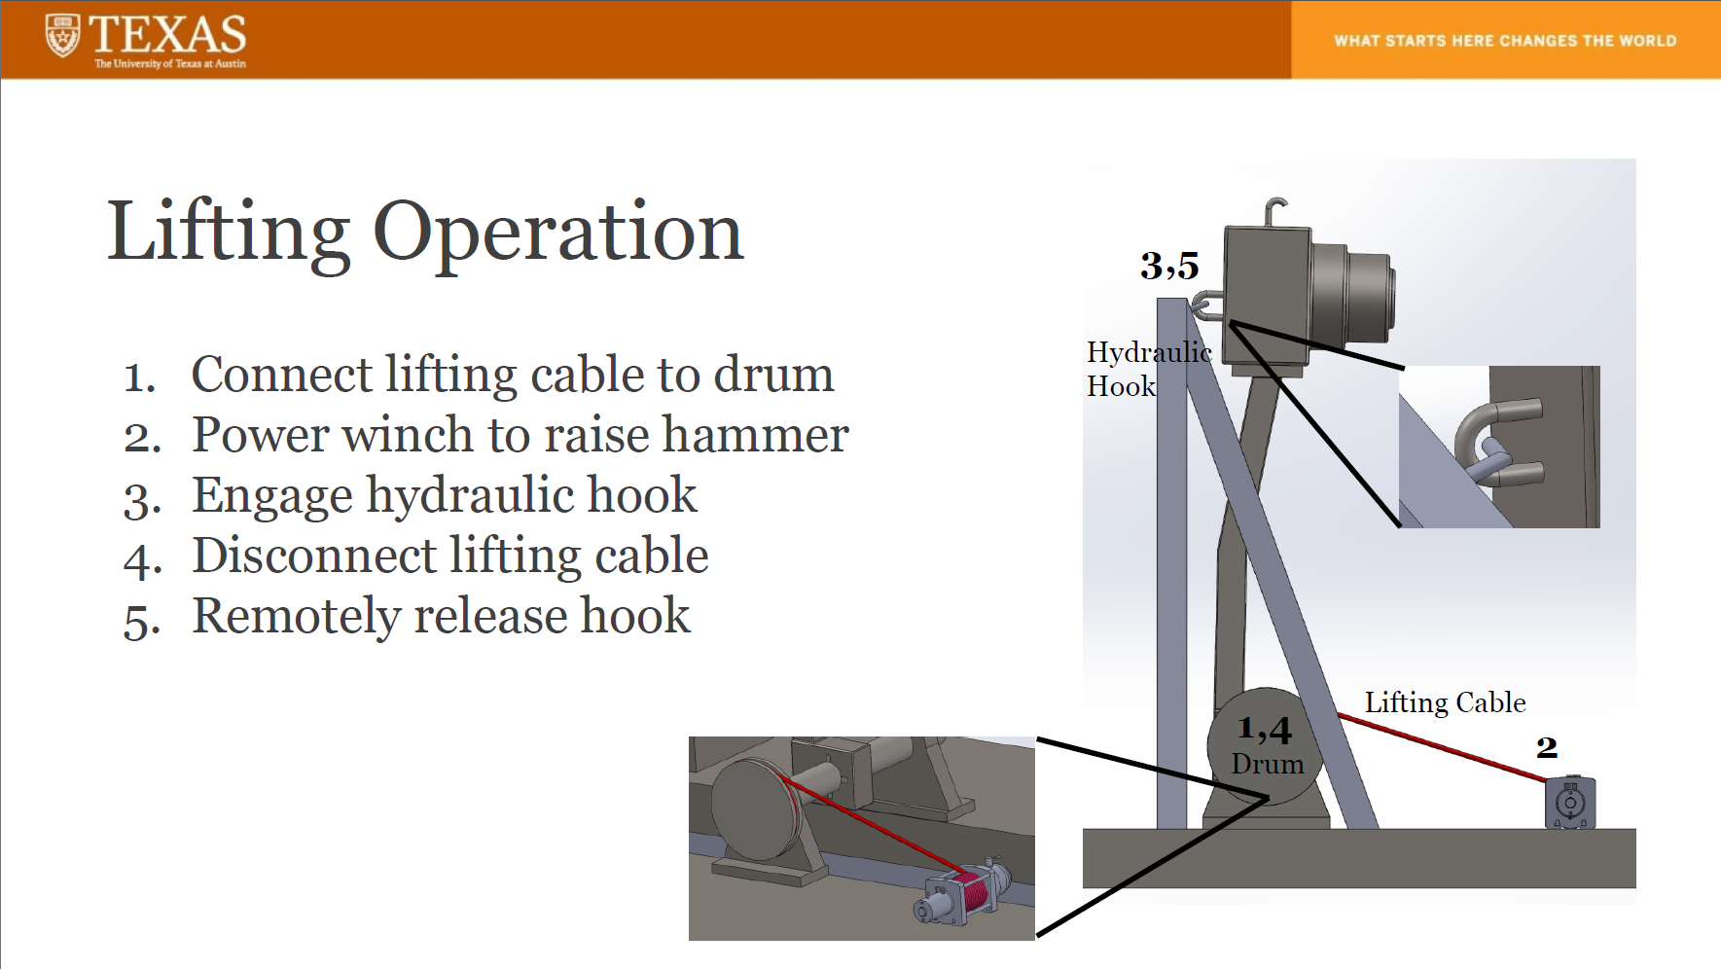
Senior Design Project Work and Results
Notes:
Besides my leader role, I was responsible for designing the Hammer, and in summary all the team members successfully delivered a CAD model and a static FEA result to the sponsor, and we wrote a report and a presentation for our sponsor and faculty members.

Slide 29
Q&A

